Slide 1

Data Science Platforms: Your Key to Actionable Analytics
WILLIAM MERCHAN | CSO, DATASCIENCE.COM
September 27, 2017

Slide 2




MY DATA SCIENCE JOURNEY
Notes:
My first real interactions with data science and using models with large data sets was pretty unique. In 2006, I had the opportunity to work with the teams building hadoop at yahoo! We used this data pipeline to do competitive analysis and forecasting in r- Unfortunately as things turned out this wasn’t the best job in the world showing how google was kicking our but to the C-level executives
The biggest challenge at that time was just getting the data in a place where you could analyze. Nothing existed so our teams had to invent it.
After yahoo i had the opportunity to join a startup focused on marketing analytics. Our teams were one of the earliest customers of aws, altiscale and H20. The use of cloud computing coupled with data science techniques opened up many new possibilities, but also had it’s own headaches in creating a system that made all of these languages and tools work together.

Slide 3
DATASCIENCE.COM STORY
2014
2017
Founded as a data science solution provider, with the goal of building the best data science tools.
Scaled from 0-50+ data scientists <2yrs, solving big data problems across industries.
Built an internal platform for our team to build and deploy models and insights more effectively.
Improvement was dramatic - brought DataScience.com Platform to market.
Notes:
We grew our team from 0 to over 50 data scientists over a very short time period. As we did that we canvased the landscape to see what was out there and if anything would match what we needed to support our needs and client requirements. Unfortunately nothing really met the requirements of what we needed to support this large team and as our clients teams grew they needed a similar offering. That aligned with open source but had the infrastructure and model deployment need required by modern technology companies.

Slide 4
Data science results should not just be limited to certain departments but be shared across the organization.
___
Director, product development and engineering, Global Telecommunications Company
Notes:
As we looked into this topic further and talked to more companies we saw that this wasn’t an isolated need. Every company is looking for a way to bring their data science projects to the forefront of what they do. This shift has happened where data science teams are now impacting front office applications and moving to the core of what a companies deliver in terms of experiences to their customers.

Slide 5
DATA SCIENCE IS NOW A CRITICAL FUNCTION IN EVERY INDUSTRY
Government
Retail
Technology
Automotive
Consumer Goods
Media
Communications
Life Sciences
& Healthcare
Gaming
Travel
Energy
Finance & Insurance
Data Science
HR
Finance
Sales
Tech & Product
Marketing
Support
Notes:
The fact that we are here at a juptyr focused conference says a lot about the state of our industry. I’m sure if we surveyed the room here we would get a broad spectrum of industries, backgrounds, and disciplines related to data science. The function itself has gone from being a back office r&d team to playing a central role. This change has required data science teams to be a team player with these other groups. They are now critical function directly influencing products and nearly every consumer interaction for sophisticated companies.

Slide 6

STATE OF THE INDUSTRY
yet only
99%
of companies think data science is an important discipline to develop…
22%
of companies are seeing significant business value from data science
Notes:
We’ve done extensive work with Forrester to dive deeper on this topic and probably not surprising to anyone in this room. Pretty much every company realizes that data science is an important discipline to develop, but very few understand and can quantify how they get value from data science. The reason why many of us are here including our company it to close this gap.

Slide 7
WHY ARE ONLY 22% OF COMPANIES GETTING VALUE FROM DATA SCIENCE? THESE THINGS ARE NEARLY IMPOSSIBLE TO ORCHESTRATE
Tools
Environments
Data
Languages
Notebooks
Laptops
Remote
Data Lake
Database
Data Inventory
Python
Jupyter
ETL
Tools
Windows
OSX
Cloud
On Prem
Scala
R Studio
R
Zeppelin
Security
AWS
Google
Azure
Cron
Spark
Hive
Pig
SAS
Libraries
Users
.ppt
Email
PMML
Chat
Email
?
Shared Drives
Logging Style A
Logging Style B
Flask
Results
Models
Code
?
Monitoring
Support
Tools
Sharing & Collaboration
Lineage and Repeatability
Deployments
Notes:
That picture that i showed you at the beginning of my background and what tools exist is one of the main drivers of this change. Connecting the systems, tools, people and process in a coherent and repeatable way is a major challenge facing all of us in the data science community……but why does this matter? What has changed that’s driving the adoption of Jupyter and data science?

Slide 8
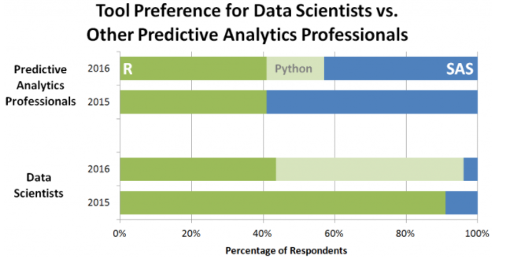
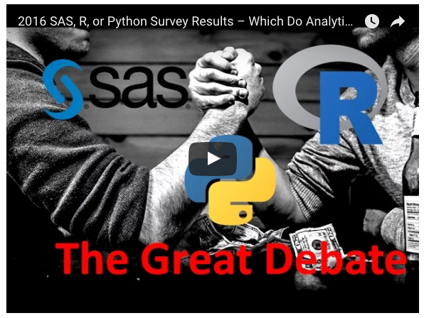
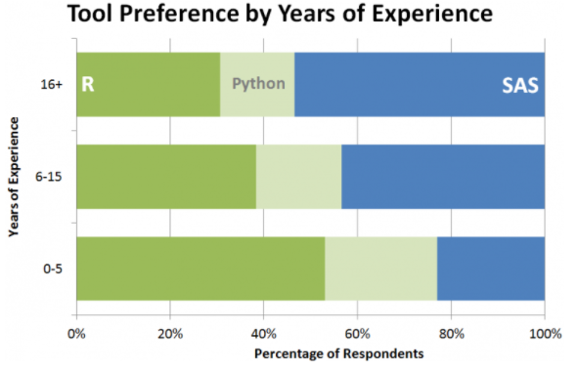
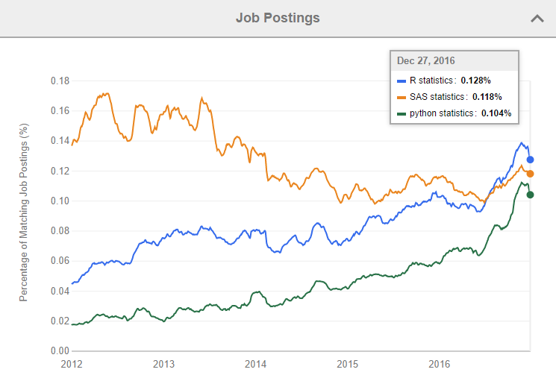
DATA SCIENCE TRENDS: OPEN SOURCE INNOVATION GROWING FAST
Source: 2016 Burtch Works survey
Notes:
If we look at what tools are being used, we see that python went from not being on the map to being the preferred tool for data scientists.

Slide 9
Data science tools alone won’t meet the demands of your organization.
Notes:
So if we know what tools are needed why hasn’t every company solved it yet? Why aren’t they applying analytics in ways that impact their business?

Slide 10

WHAT IS A DATA SCIENCE PLATFORM?
A data science platform contains tools and workflow needed for the entire life cycle of data science work: data integration and exploration, model development, and model deployment.

Slide 11


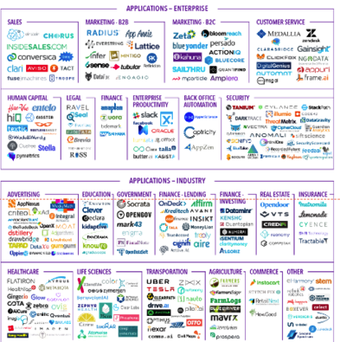


















DATASCIENCE PLATFORMS ARE EMERGING CATEGORY BRINING TOGETHER ESSENTIAL ELEMENTS FOR DATA SCIENCE SCALING
ETL & DATA ENGINEERING
DATA SCIENCE PLATFORMS
BI & VISUALIZATION TOOLS
VERTICAL APPLICATIONS
TOOLS
LIBRARIES
INFRASTRUCTURE
SECURITY
DATA PLATFORMS
CLOUD PROVIDERS
Notes:
We’ve seen this need as an opportunity, but platforms on their own are only part of the picture.
To make it all work together you need to consider the tools, libraries, infrastructure, security, and underlying capacity required.
The platform also needs to tightly integrate with your data platforms, data engineering and BI Tools adopted across the organization.

Slide 12
Deep Learning
What can you do with the DataScience.com Platform?
Artificial Intelligence
Machine Learning
CONFIDENTIAL | DATASCIENCE.COM
Notes:
By having a platform you remove the roadblocks to using deep learning, AI and ML. Dependency management, installing packages, and provisioning the machines need to run these analysis becomes much easier.

Slide 13
What can you do with the DataScience.com Platform?
Scale Data Science
CONFIDENTIAL | DATASCIENCE.COM
Notes:
Scale, what do we mean by this?

Slide 14
WHAT DOES IT MEAN TO ‘SCALE DATA SCIENCE’?
When we say “scaling data science”, we’re talking about making your data science team the engine that powers every decision with powerful predictive models and comprehensive analyses
Notes:
There is a short list of companies that have done this….Google, Facebook, Amazon also companies like GE

Slide 15
WHAT DOES IT MEAN TO ‘SCALE DATA SCIENCE’?
Scaling data science across the entirety of an organization requires extensive resources and a defined roadmap, as well as the right tools, processes, infrastructure, and a plan for putting work into production.
DATA SCIENCE PLATFORM
1
Tools and Processes
2
Infrastructure and Environments
3
Production
Notes:
Defining your roadmap and developing a plan is well worth the effort. We’ve seen these three areas being the key to success or failure in driving scale at the enterprise.
We will dive into what they mean and how a data science platform supports them.

Slide 16
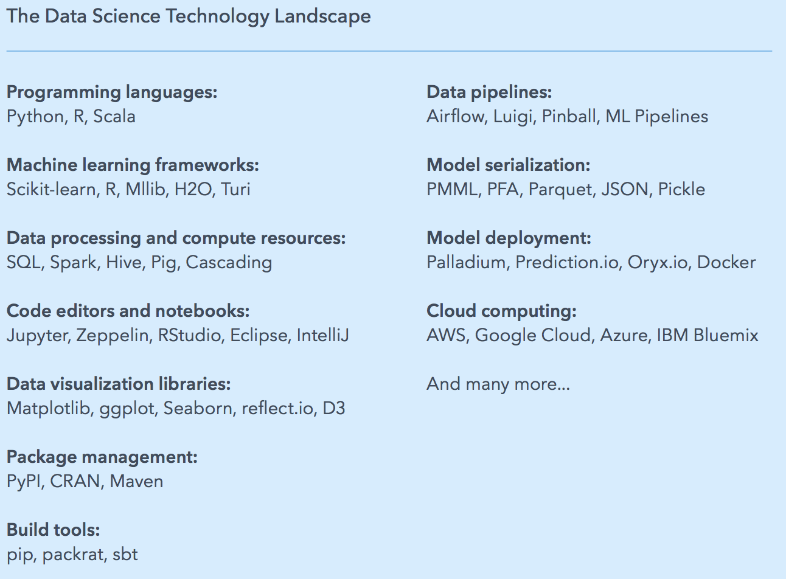
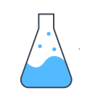

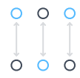
DATA SCIENCE PLATFORM: TOOLS AND PROCESSES
Experiment
Create work that is reproducible
Collaborate and share across teams
Notes:
These are some of the key technologies that working together can make up the tool landscape at a company. Keep in mind that these tools need to align with how your engineering team has built your applications.
The more alignment the better between the data science team and engineering to remove any friction points on moving models to production. The process of how you do data science will vary based on your development cycles and what your team is producing.
We’ve found that experimentation, reproducibility, and collaboration regardless of your specific workflow will ensure better and more widely adopted results.

Slide 17

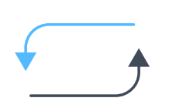

DATA SCIENCE PLATFORM: INFRASTRUCTURE AND ENVIRONMENTS
On-demand computing resources
Standardized data science environments
Access control
Notes:
Getting the right compute resources into your data scientists hands in the moment that they need it is a basic requirement for doing this work. We’ve seen this task can be very challenging though depending on the internal process with IT and who owns that pool of compute resources internally.
It’s really important to work out what turnaround time your team needs and ironing out this process so teams aren’t waiting to get the machines they need to start working.
Some of the most advanced teams have now built out internal hubs for data science where part of their remit is research and defining the data science environments for the organization. Having this in place reduces the amount of research needed when getting started with model development and removes some of the uncertainty on if a particular library will work as expected.
By it’s very nature data science work is using the most sensitive data at the organization. It can be something simple like AWS access keys or even user level highly sensitive data. Defining who has access to what data and models and aligning that with your internal rules is often very challenging using off the shelf open source tools, this is typically where commercial platforms or internal development kicks in.

Slide 18

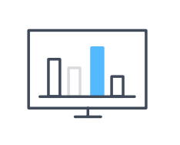
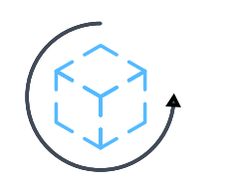
DATA SCIENCE PLATFORM: PRODUCTION
Automation of repetitive tasks
Ongoing monitoring of model performance
Constant improvement
Notes:
As data science moves to the core it means more of what everyone in this room creates makes it way to production.
A platform should support this need by reducing any friction in the process. Automating tasks that shouldn’t require custom coding each time – auto synching with github as an example.
As these models move into the next step of their lifecycle the original developers and ops team will need to review and monitor performance. Having this closed loop of data coming in ensures the model is performing as expected. If not, that’s where the ability to go back in and create new model versions, re-deploy these models and collaborate with the team can happen.

Slide 19
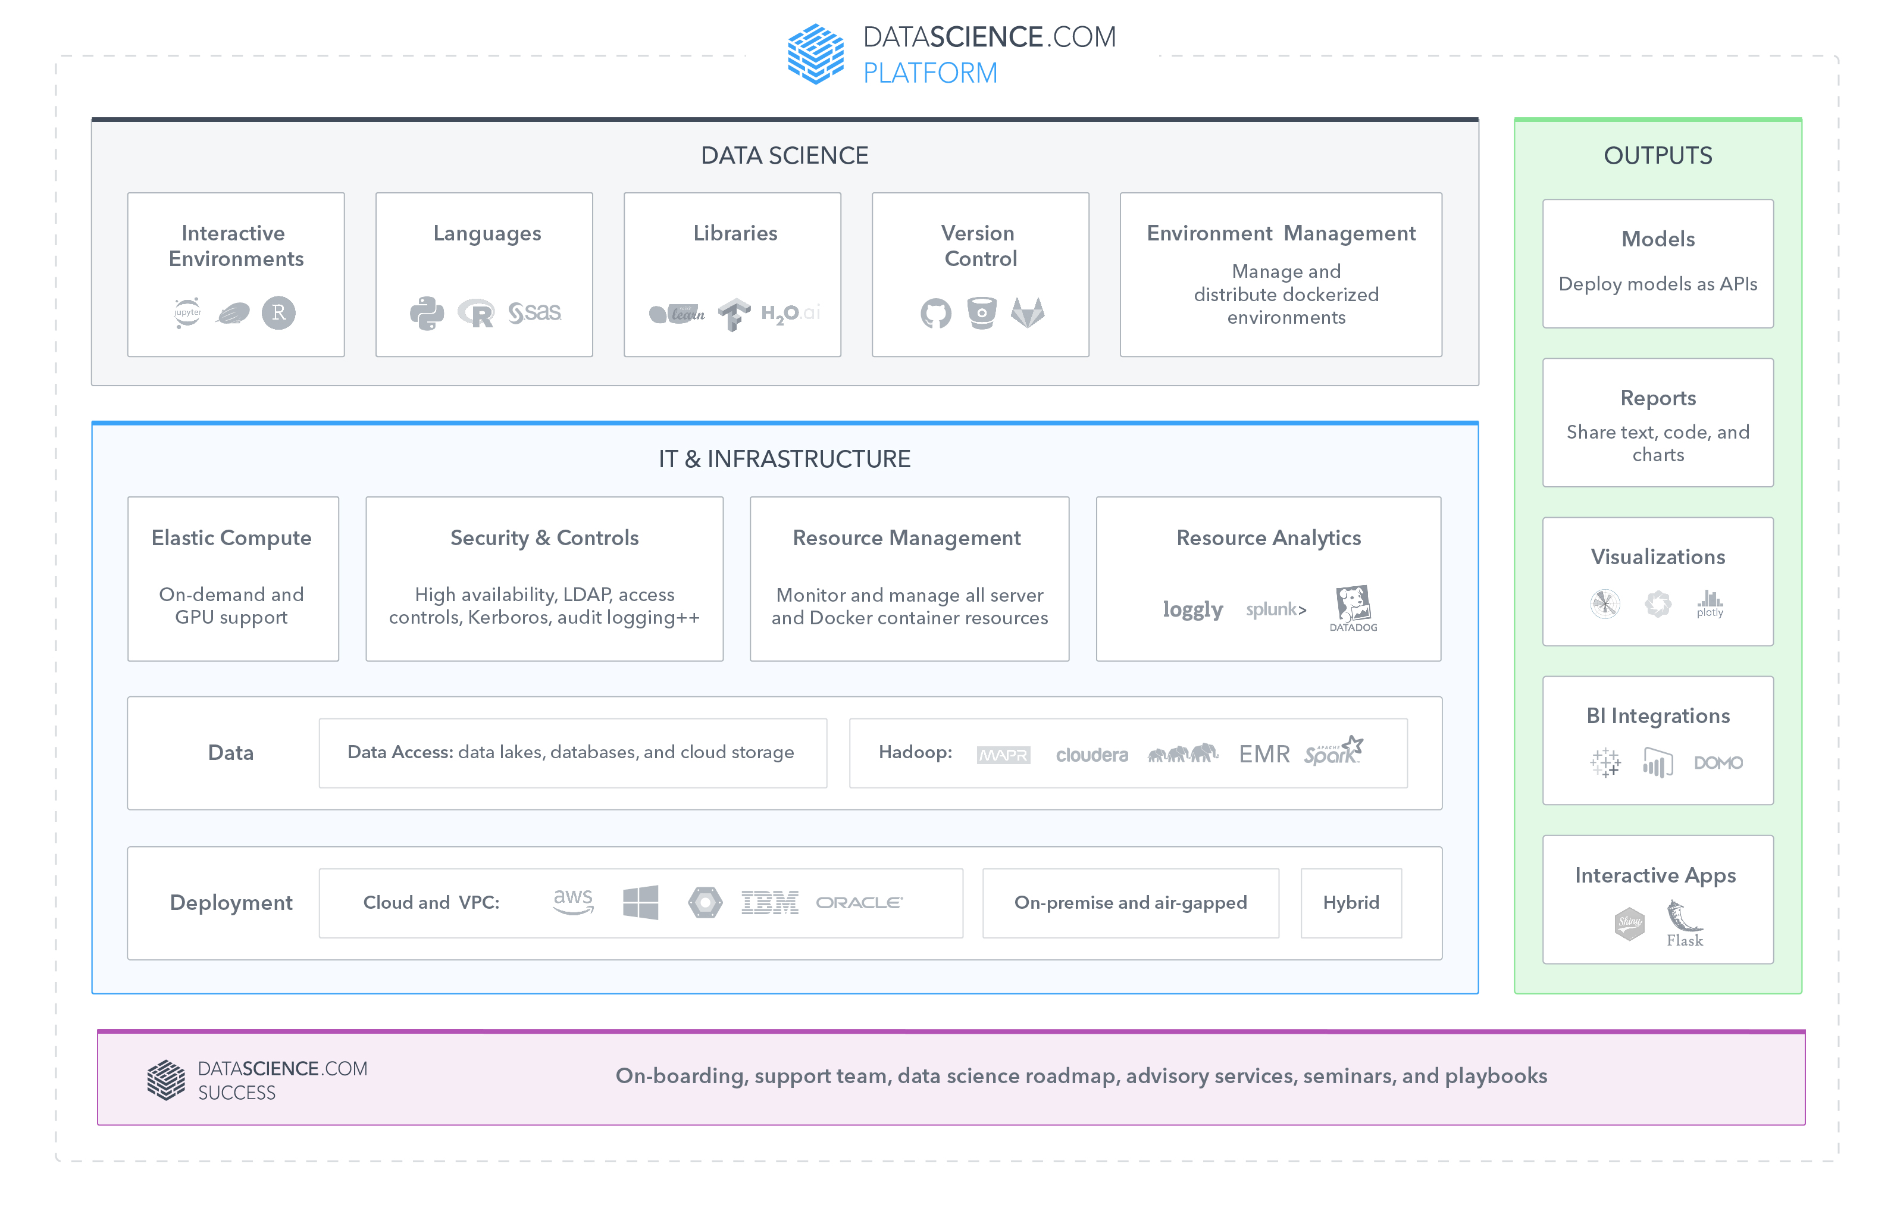
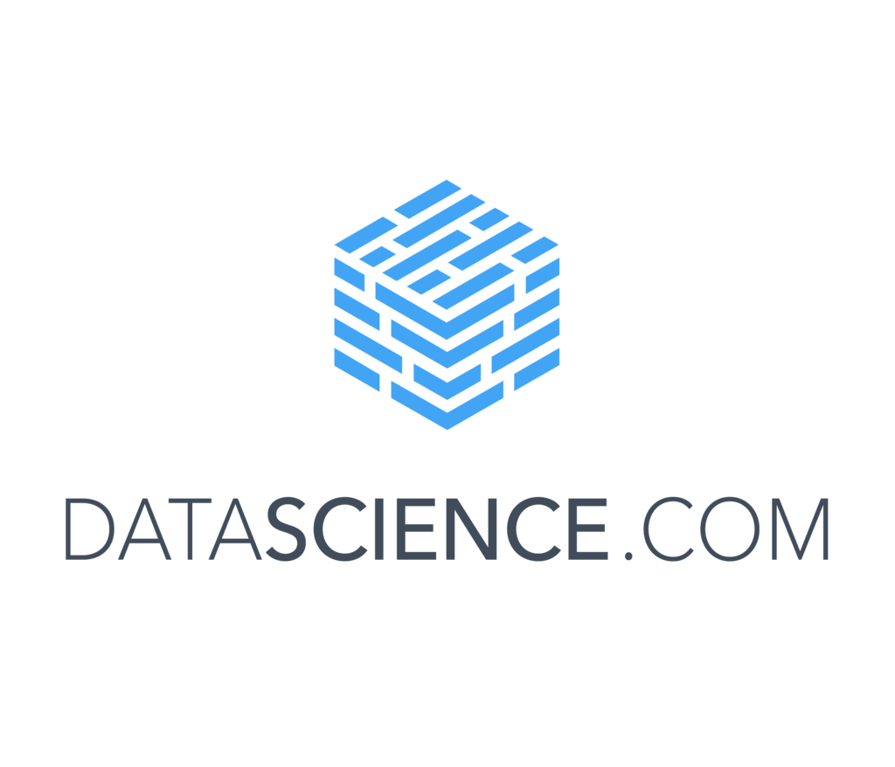
________
The DataScience.com Platform combines the tools, libraries, and languages your team loves with the infrastructure and workflows your organization needs.
Notes:
So how does all this come together? Here is what we’ve built. The three areas of the platform align to what we covered on Tools, Infrastructure, and Outputs.
The key to successful adoption and use of a platform is bringing all these technologies together in unified approach, and backing that up with a team to help guide the ship and support the development of best practices.

Slide 20
USE CASES ON THE PLATFORM
Marketing Response Models
Scheduled Jobs
Customer churn
APIs
Lifetime Value
Apps
Text sentiment analysis
Reports
Computer vision and image tagging
Apps
Empower data scientists with best-in-class tools, infrastructure, and expertise.
Forecasting
Reports
Risk management with machine learning
APIs
Recommendation engines
APIs
Transactional data ETL
Scheduled Jobs
Data discovery and auditing
Reports
Notes:
This all comes to life in products that teams can now produce for their internal customers. These are some examples of what teams can develop.
The models can be supporting internal reports, applications, or data pipelines.

Slide 21
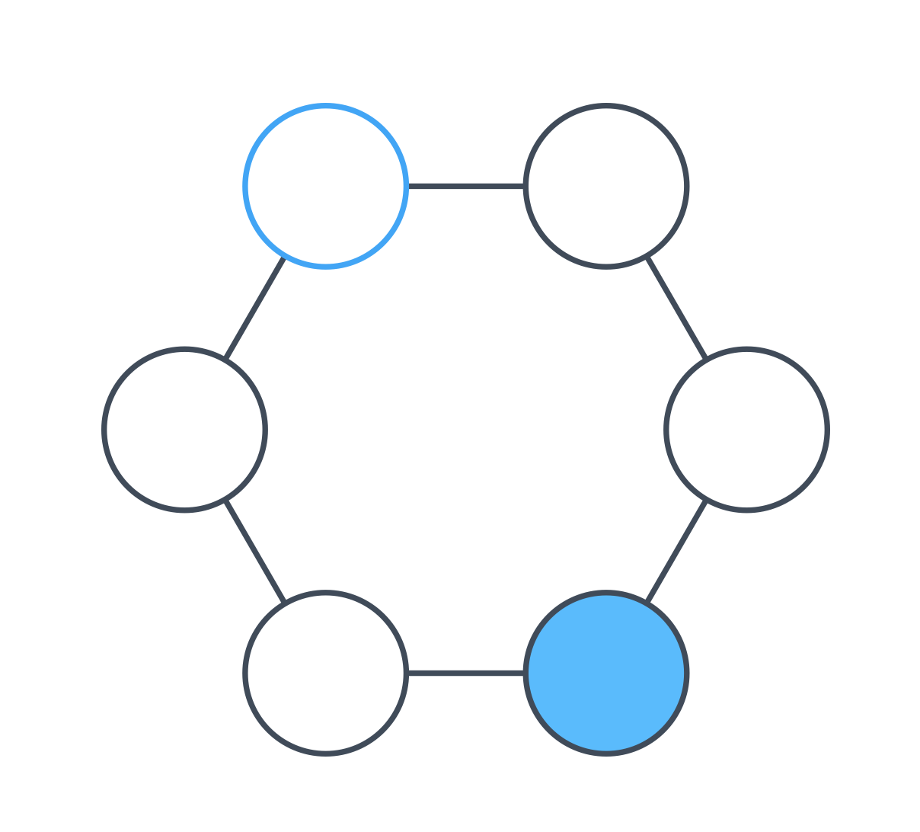
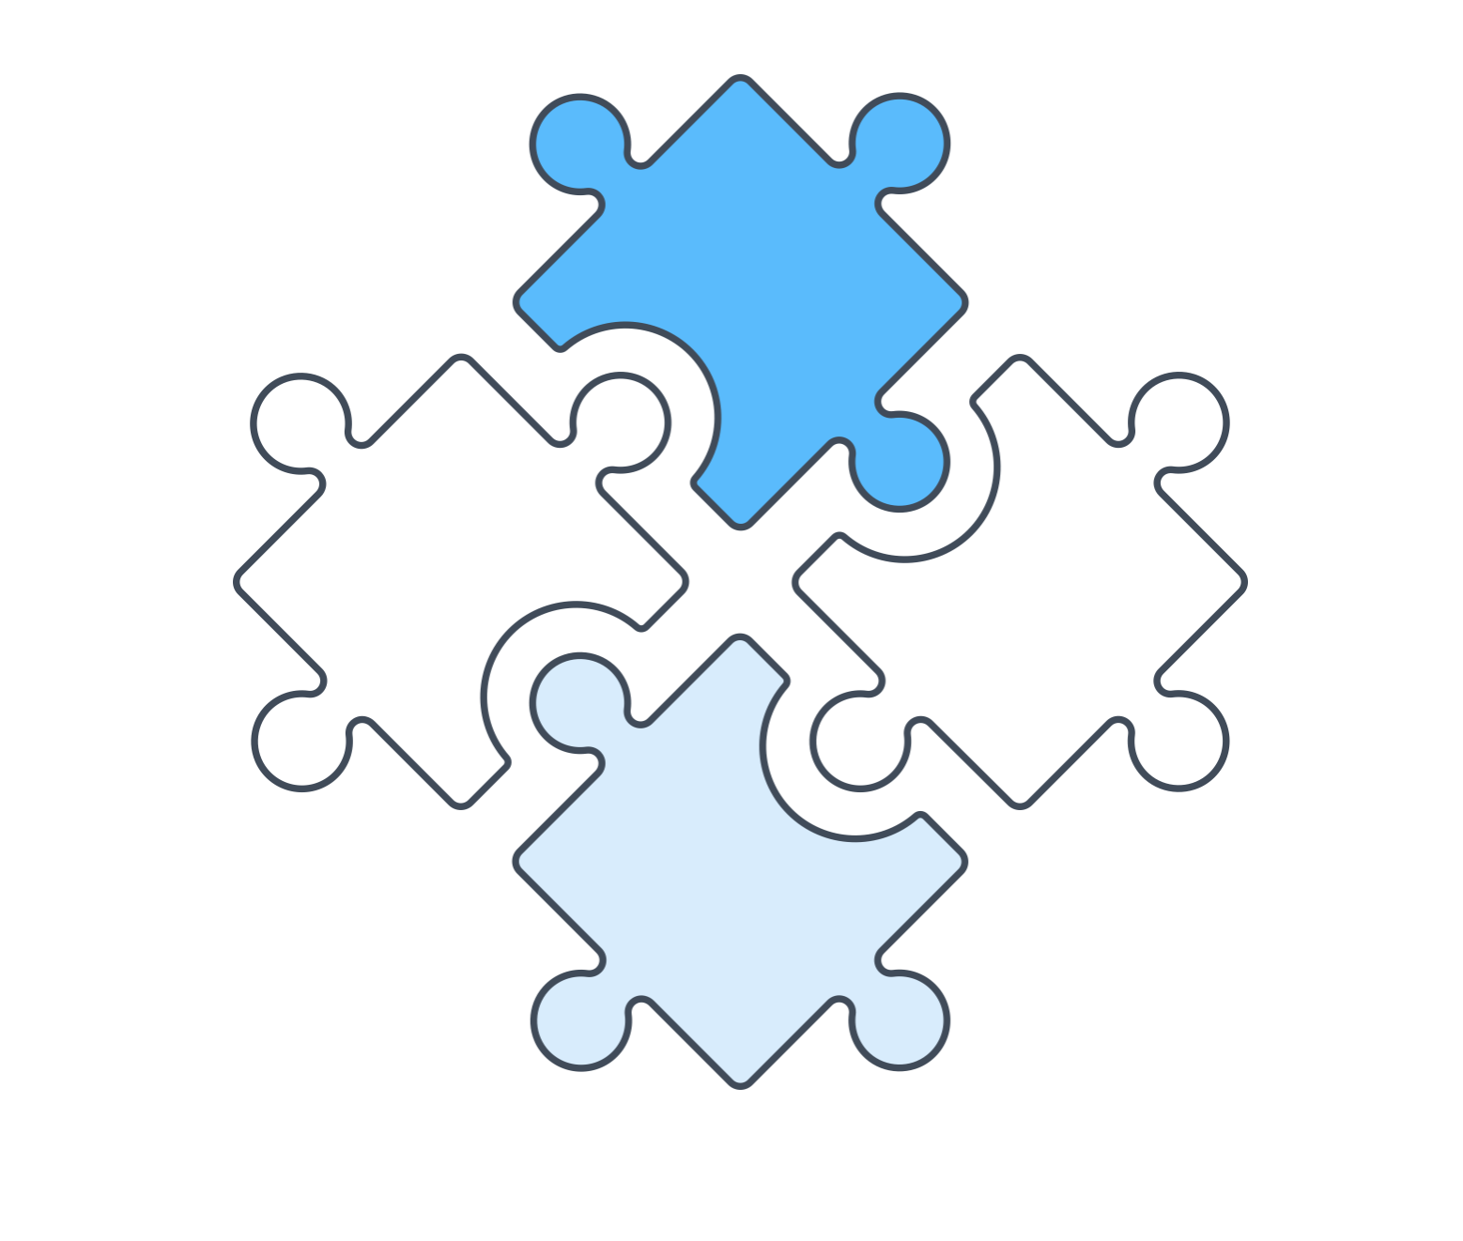
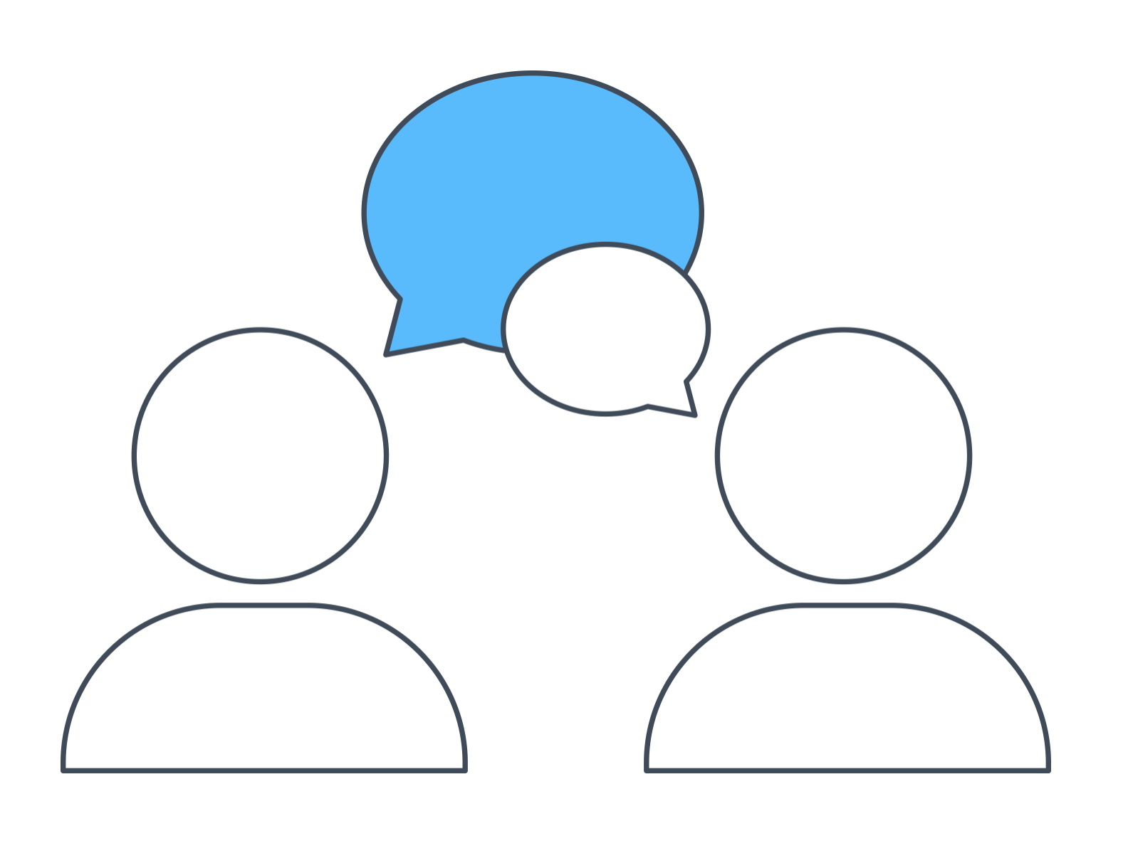
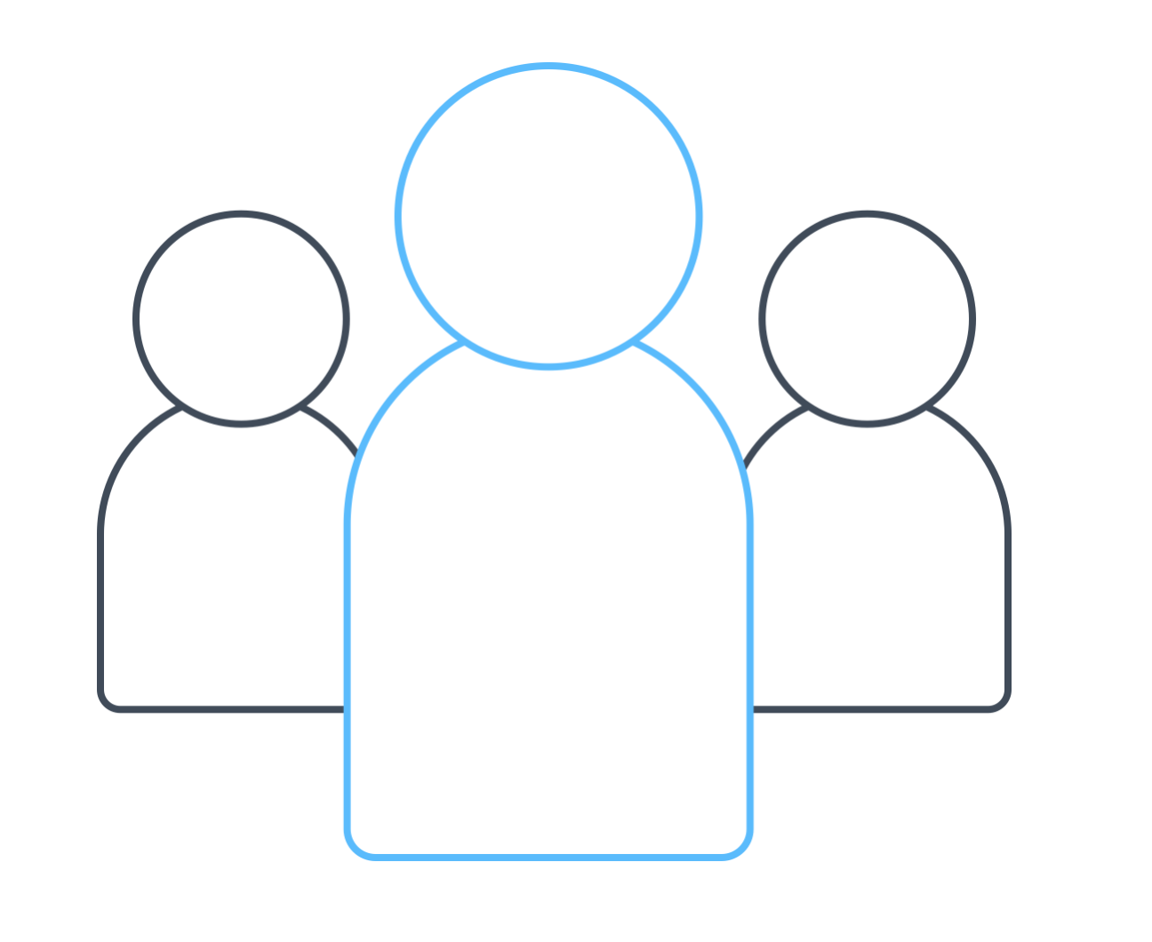
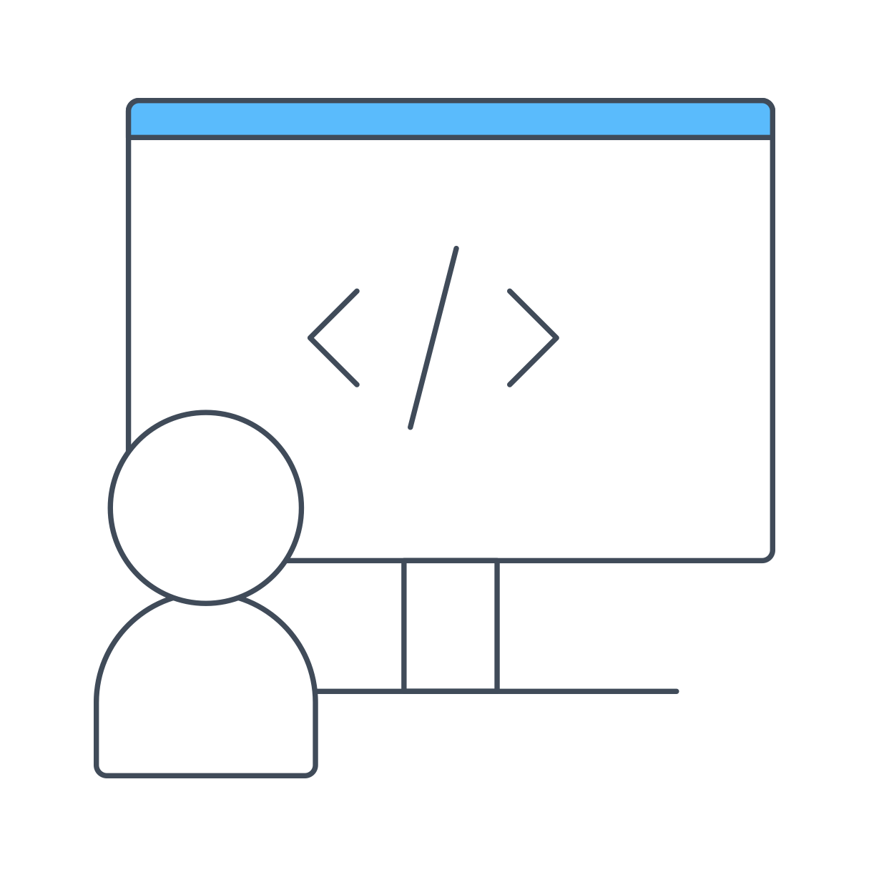
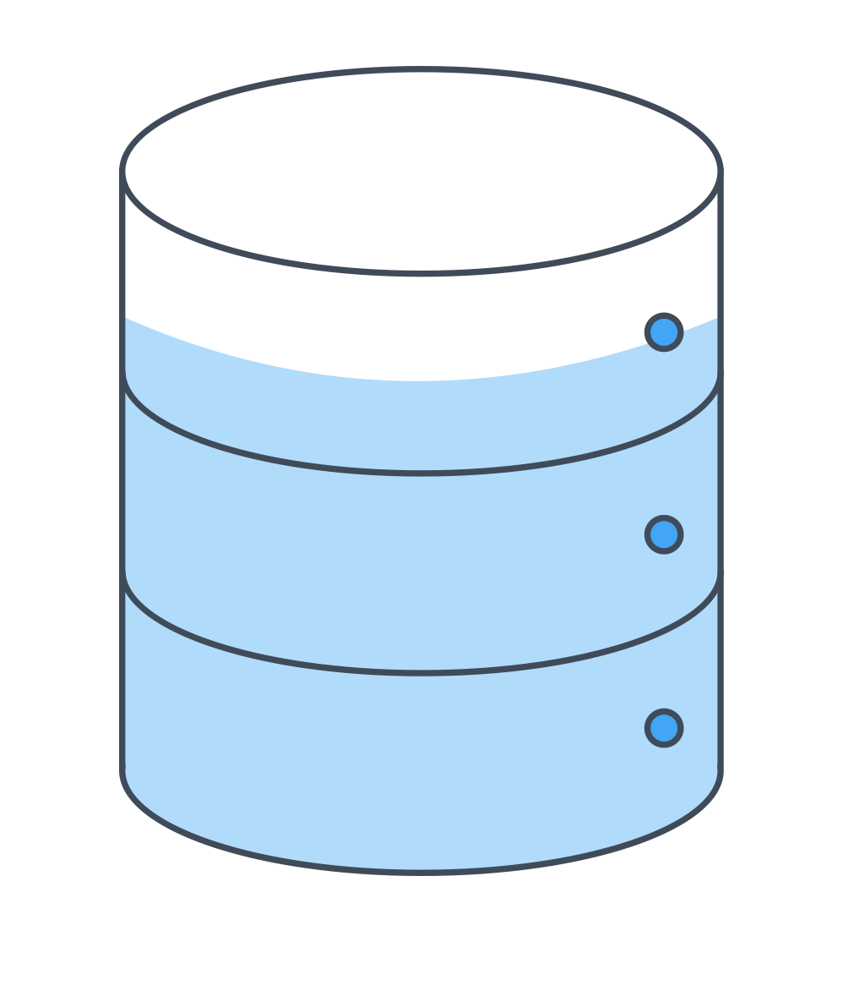
INDUSTRY LEADING DATA SCIENCE ORGANIZATIONS
Define and prioritize data science projects early on
Foster communication between data scientists and business users
Embed data scientists in the organization
Use data scientists for data science
Consider data science when doing data collection
Borrow from engineering
Notes:
These are the traits of those teams that lead the pack.
Two of these that I’d like to highlight are embedding data scientists in the organization. Building out a pod structure where a data scientist is paired with a product and engineering partner to iterate and develop quickly support a dedicated use case. You can get significant performance improvements by making this small change and focusing a nimble team to get the job done.
The second is using data scientists to do data science. In way too many companies we’ve seen data scientists pulled into doing basic etl work or data cleansing. Which certainly needs to happen, but it’s better to fix this at the root cause. Which usually has to do with bringing the data science early and often when defining your data collection strategies and systems to make sure the structure and output matches what they need to develop models.

Slide 22
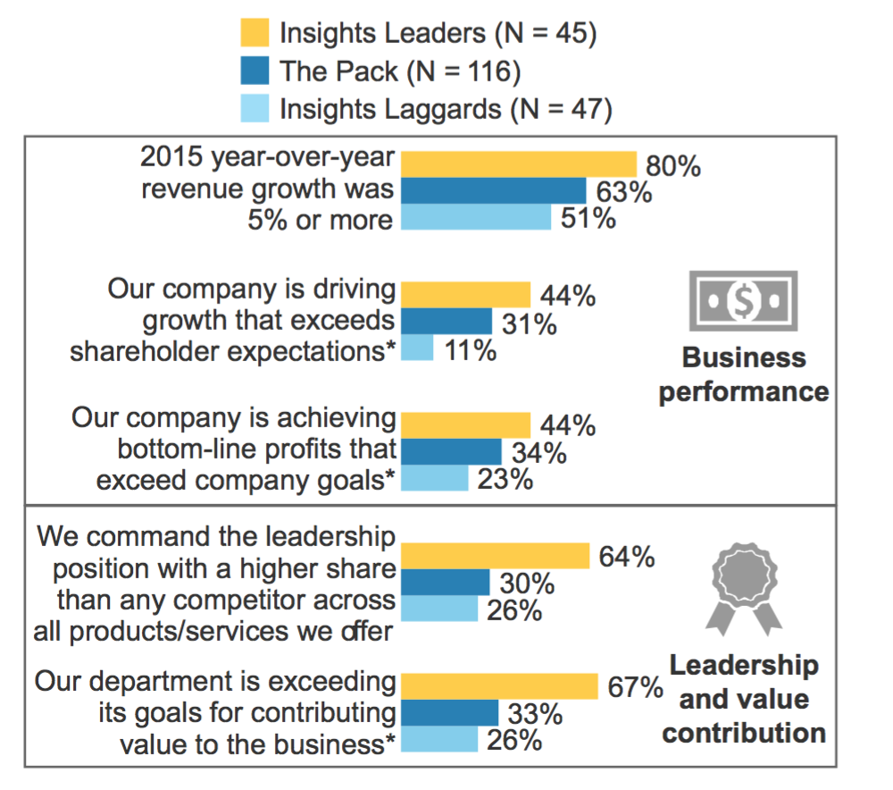

INSIGHTS LEADERS OUTPERFORM OTHER FIRMS
Notes:
Why should you do this? Well the good news is that it translates very clearly to revenue growth and profitability.
The companies that have become insights leaders are applying these best practices and beating their competitors.

Slide 23
KEY RECOMMENDATIONS
Unify data science technology into a single, unified platform.
Make data science transparent and part of the business decision making.
Improve collaboration and knowledge management to mitigate turnover and increase efficiencies.
Treat data science platforms as a strategic, transformative investment.
William Merchan CSO, DataScience.com
william@datascience.com

Slide 24
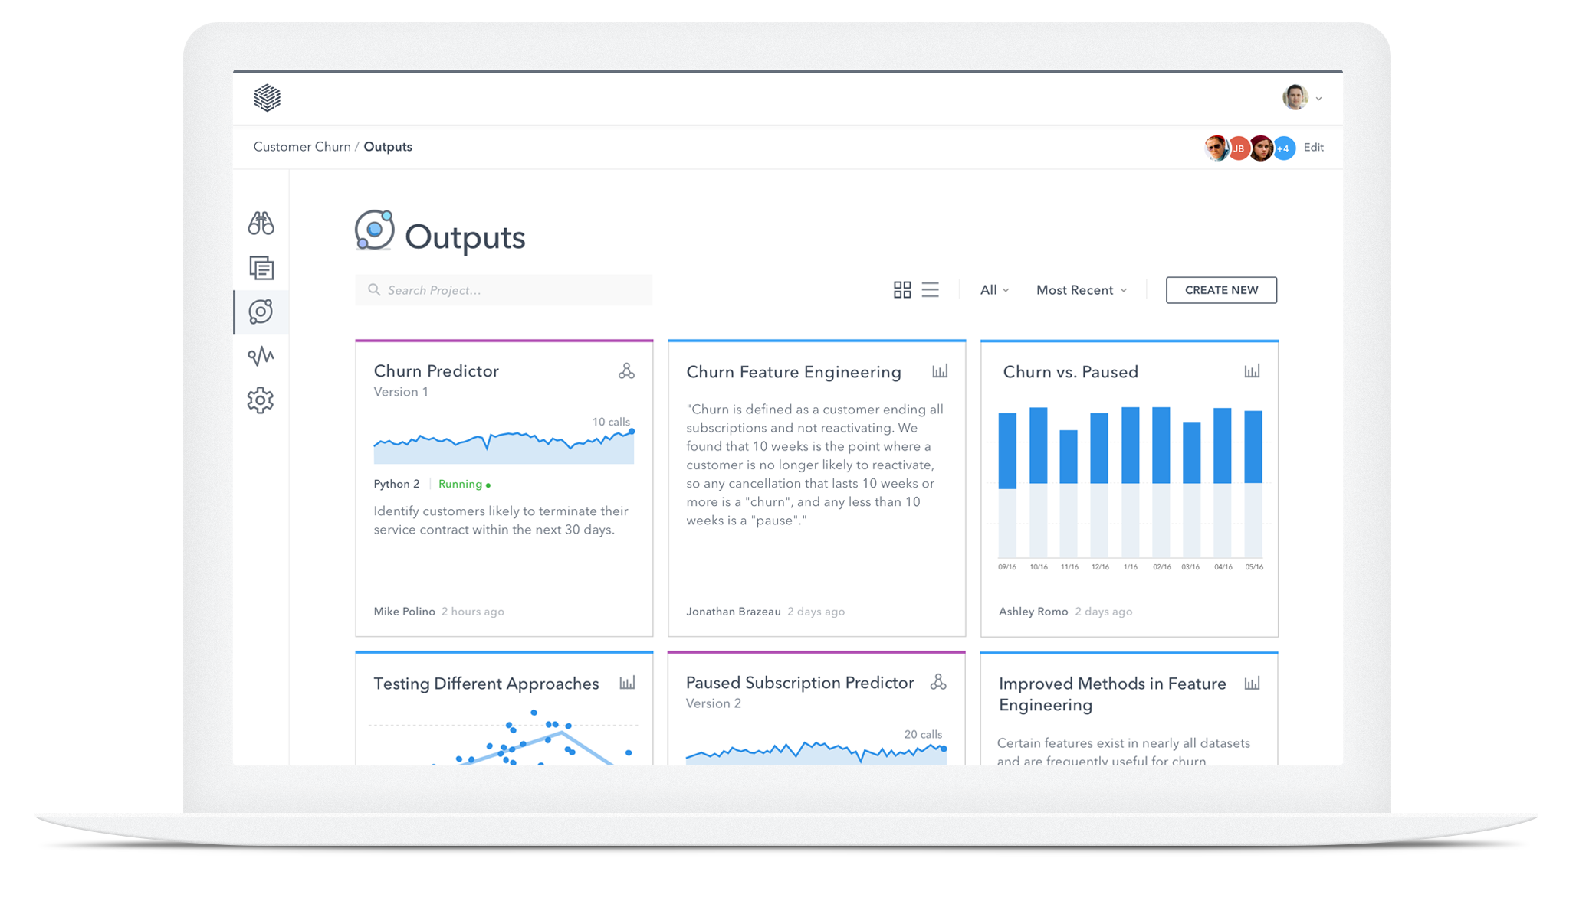
DataSCIENCE.COM
About ______
DataScience.com provides an enterprise data science platform that combines the tools, libraries, and languages data scientists love with the infrastructure and workflows their organizations need.
The DataScience.com Platform maximizes the way data scientists like to work, so they can solve the right problems, create better analyses, amplify their results, and put more work into production -- all from one place.

Slide 25
William Merchan william@datascience.com | @williammerchan
Thank you

